Slide 1
Decision Tree
Course : COMP6065001 Artificial Intelligence
Effective Period : September 2023
Session : 17

Slide 2
Learning Outcomes
At the end of this session, students will be able to:
LO 4 Apply various learning algorithms to solve the problems

Slide 3
Outline
Tree Terminology
Rule Based Learning
Decision Tree
Exercise

Slide 4
Introduction
Decision tree algorithms can be considered as an iterative, top-down construction of the hypothesis; picture a hierarchy of decision, forking the dataset into subspaces.
Can represent any Boolean (binary) function, and the hypothesis space being searched is the entire space of Boolean functions
Considering only binary (or Boolean) features, at each node, there 2^{m} potential splits to be evaluated given m features

Slide 5
Terminology
Root node: no incoming edge, zero or more outgoing edges.
Internal node: one incoming edge, two (or more) outgoing edges.
Leaf node: each leaf node is an assigned a class label (if nodes are pure; otherwise majority vote).
Parent and child nodes: If a node is split, we refer to that given node as the parent node, and the resulting nodes are called child nodes, respectively.

Slide 6
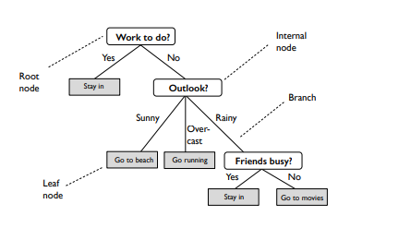
Terminology
Figure 1: Example of non-binary decision tree with categorical feature

Slide 7
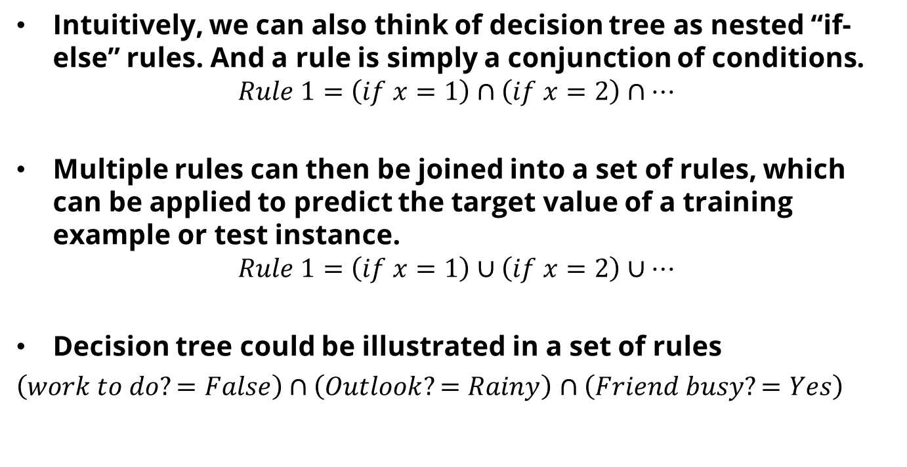
Relationship between Decision Tree and Rule based learning
Intuitively, we can also think of decision tree as nested “if-else” rules. And a rule is simply a conjunction of conditions.
$$Rule 1=\left(if x=1\right)∩\left(if x=2\right)∩…$$
Multiple rules can then be joined into a set of rules, which can be applied to predict the target value of a training example or test instance.
$$Rule 1=\left(if x=1\right)∪\left(if x=2\right)∪…$$
Decision tree could be illustrated in a set of rules
$\left(work to do?=False\right)∩\left(Outlook?=Rainy\right)$ $∩\left(Friend busy?=Yes\right)$

Slide 8
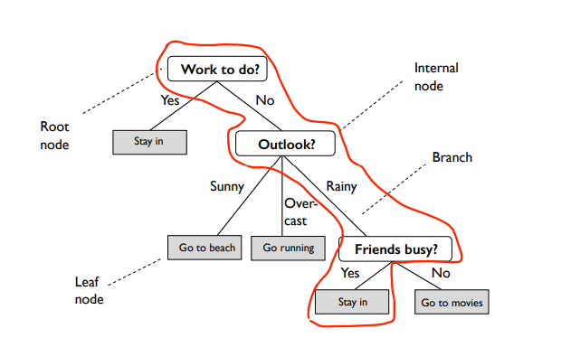

Slide 9
Exercise
From Figure 1. create A Rule Set, you want the result is stay in?

Slide 10
Relationship between Decision Tree and Rule based learning
Rules can be constructed from decision trees easily: each leaf node is a rule.
It is not possible to always build a decision tree from a set of rules, and in cases where it is obvious, it may not be immediately apparent how (especially if rules were pruned)
Evaluating a rule set is much more expensive than evaluating a tree, where we only have to go to one single branch
Rulesets can have multiple answers if we are not careful.
While rules are more expressive or flexible, they are more prone to overfitting, because they have a larger hypothesis space than decision trees.

Slide 11
General Based Decision Tree Algorithm
The process of growing a decision tree can be expressed as a recursive algorithm as follows:
Pick the feature that when parent node is split, it results in the largest information gain
Stop if child nodes are pure or no improvement in class purity can be made
Go back to step 1 for each of the two child nodes

Slide 12
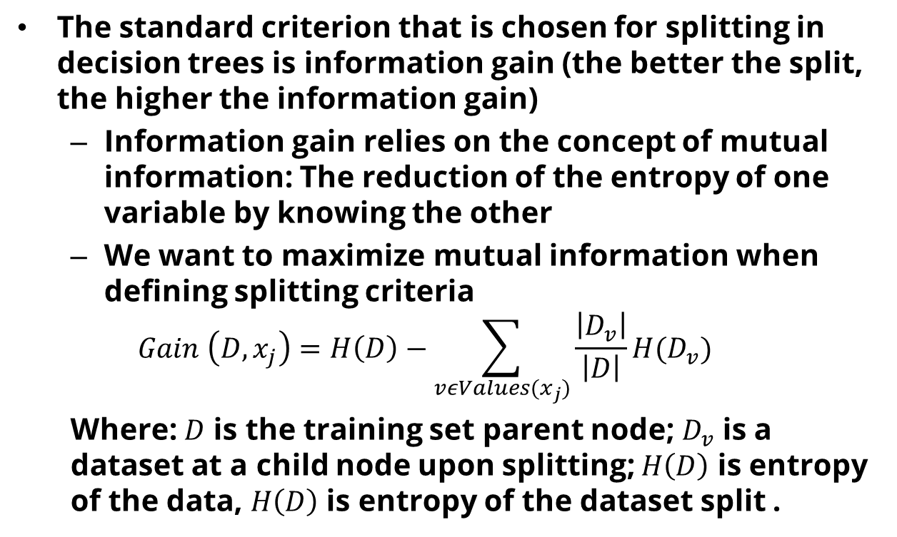
Information Gain
The standard criterion that is chosen for splitting in decision trees is information gain (the better the split, the higher the information gain)
Information gain relies on the concept of mutual information: The reduction of the entropy of one variable by knowing the other
We want to maximize mutual information when defining splitting criteria
$$Gain \left(D,x_{j}\right)=H\left(D\right)−\sum_{vεValues(x_{j})}{\frac{\left|D_{v}\right|}{\left|D\right|}H(D_{v})}$$
Where: $D$ is the training set parent node; $D_{v}$ is a dataset at a child node upon splitting; $H\left(D\right)$ is entropy of the data, $H\left(D\right)$ is entropy of the dataset split .

Slide 13
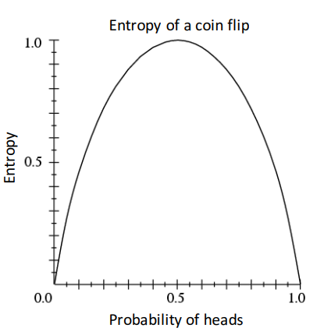
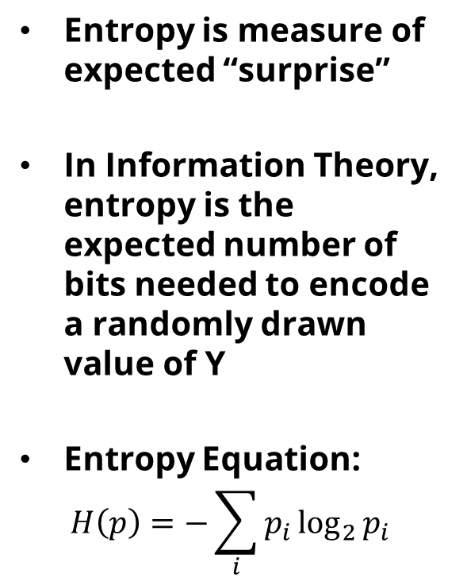
Entropy
Entropy is measure of expected “surprise”
In Information Theory, entropy is the expected number of bits needed to encode a randomly drawn value of Y
Entropy Equation:
$$H\left(p\right)=−\sum_{i}{p_{i}}\log_{2}{p_{i}}$$

Slide 14
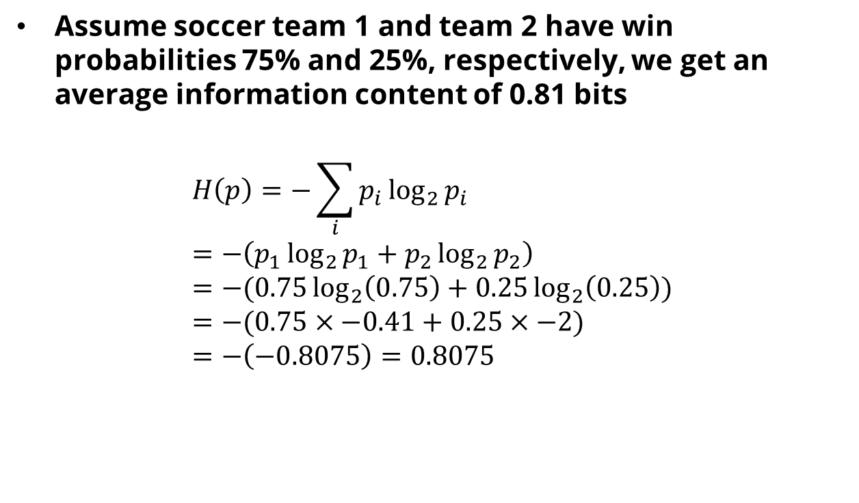
Entropy
Assume soccer team 1 and team 2 have win probabilities 75% and 25%, respectively, we get an average information content of 0.81 bits
$$H\left(p\right)=−\sum_{i}{p_{i}}\log_{2}{p_{i}} \\ =−\left(p_{1}\log_{2}{p_{1}}+p_{2}\log_{2}{p_{2}}\right) \\ =−(0.75\log_{2}\left(0.75\right)+0.25\log_{2}\left(0.25\right)) \\ =−(0.75×−0.41+0.25×−2) \\ =−\left(−0.8075\right)=0.8075$$

Slide 15
Entropy
The key idea behind Shannon entropy is that we can use entropy as a way to create messages of different lengths to transmit different information contents send information more efficiently (saving bits)
In the decision tree context, entropy is using minimum number of bits that are required to encode the classification of data points.
For instance, if we have p = 0.5 (uniform class distribution in a binary classification problem) we need to send 1 bit on average (most expensive) to classify a data point.

Slide 16
Entropy
“High Entropy”:
Variable has a uniform like distribution
Flat histogram
Values sampled from it are less predictable
“Low Entropy”:
Distribution of variable has many peaks and valleys
Histogram has many lows and highs
Values sampled from it are more predictable

Slide 17
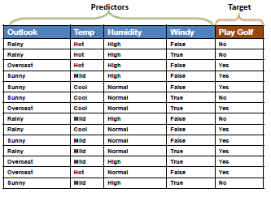
Example of Decision Tree

Slide 18
Algorithm of Decision Tree
Pick the feature that when parent node is split, it results in the largest information gain
Stop if child nodes are pure or no improvement in class purity can be made
Go back to step 1 for each of the two child nodes

Slide 19
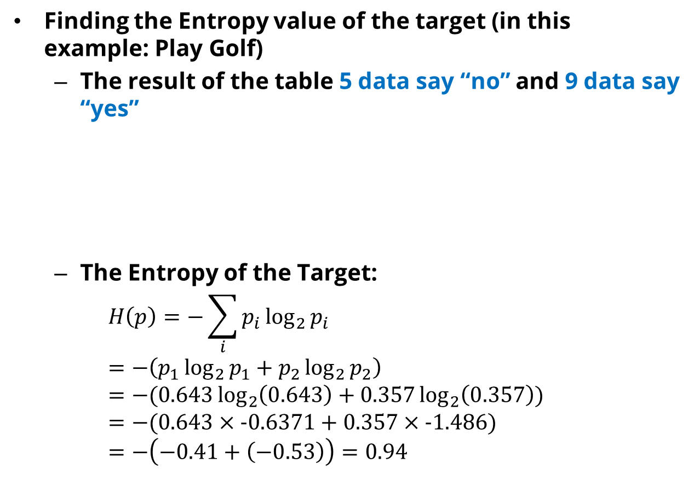
Find the Information Gain
Finding the Entropy value of the target (in this example: Play Golf)
The result of the table 5 data say “no” and 9 data say “yes”
The Entropy of the Target:
$$H\left(p\right)=−\sum_{i}{p_{i}}\log_{2}{p_{i}} \\ =−\left(p_{1}\log_{2}{p_{1}}+p_{2}\log_{2}{p_{2}}\right) \\ =−(0.643\log_{2}\left(0.643\right)+0.357\log_{2}\left(0.357\right)) \\ =−(0.643×−0.6371+0.357×−1.486) \\ =−\left(−0.41+\left(−0.53\right)\right)=0.94$$
 | Play Golf |  | Total
 | Yes | No
 | 9 | 5 | 14
Probability | 9/14= 0.643 | 5/14 = 0.357 | 1.0

Slide 20
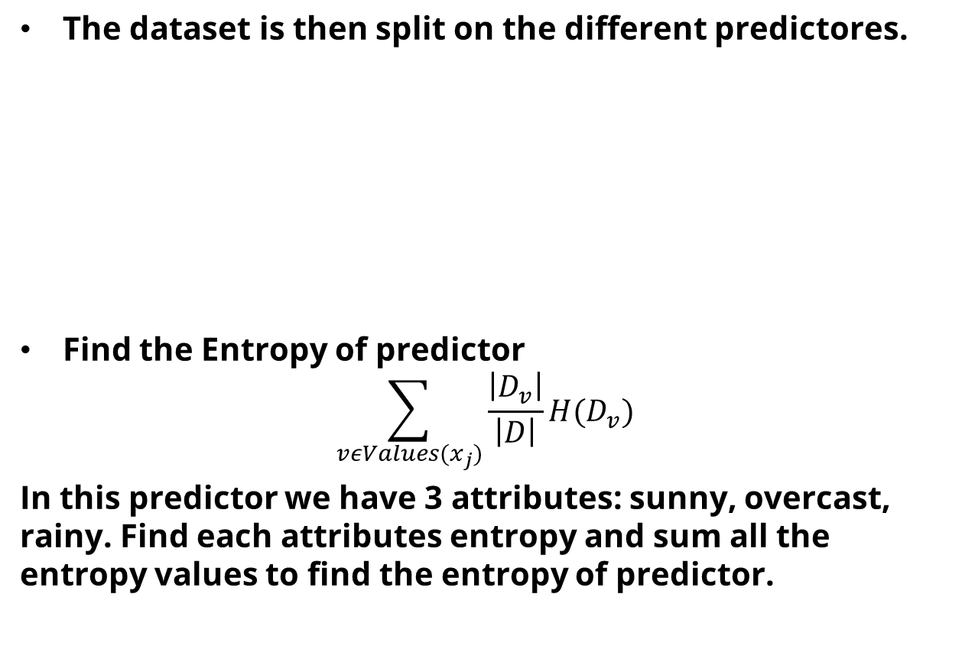
Find The Information Gain
The dataset is then split on the different predictores.
Find the Entropy of predictor
$$\sum_{vεValues(x_{j})}{\frac{\left|D_{v}\right|}{\left|D\right|}H(D_{v})}$$ In this predictor we have 3 attributes: sunny, overcast, rainy. Find each attributes entropy and sum all the entropy values to find the entropy of predictor.
 |  | Play Golf |  | Total
 |  | Yes | No
Outlook | Sunny | 3 | 2 | 5
 | Overcast | 4 | 0 | 4
 | rainy | 2 | 3 | 5

Slide 21

Find The Information Gain
Entropy of Outlook Sunny
$$\frac{\left|D_{v}\right|}{\left|D\right|}H\left(D_{v}\right) \\ =\frac{5}{14}H\left(3,2\right) \\ =\frac{5}{14}\left(−\sum_{i}{p_{i}}\log_{2}{p_{i}}\right) \\ =\frac{5}{14}\left(−\left(\frac{3}{5}\log_{2}\left(\frac{3}{5}\right)+\frac{2}{5}\log_{2}\left(\frac{2}{5}\right)\right)\right)=0.347$$
 |  | Play Golf |  | Total
 |  | Yes | No
Outlook | Sunny | 3 | 2 | 5
 | Overcast | 4 | 0 | 4
 | rainy | 2 | 3 | 5

Slide 22

Find The Information Gain
Entropy of Outlook Overcast
$$\frac{\left|D_{v}\right|}{\left|D\right|}H\left(D_{v}\right) \\ =\frac{4}{14}H\left(4,0\right) \\ =\frac{4}{14}\left(−\sum_{i}{p_{i}}\log_{2}{p_{i}}\right) \\ =\frac{4}{14}\left(−\left(\frac{4}{4}\log_{2}\left(\frac{4}{4}\right)+\frac{0}{4}\log_{2}\left(\frac{0}{4}\right)\right)\right)=0$$
 |  | Play Golf |  | Total
 |  | Yes | No
Outlook | Sunny | 3 | 2 | 5
 | Overcast | 4 | 0 | 4
 | rainy | 2 | 3 | 5

Slide 23

Find The Information Gain
Entropy of Outlook rainy
$$\frac{\left|D_{v}\right|}{\left|D\right|}H\left(D_{v}\right) \\ =\frac{5}{14}H\left(2,3\right) \\ =\frac{5}{14}\left(−\sum_{i}{p_{i}}\log_{2}{p_{i}}\right) \\ =\frac{5}{14}\left(−\left(\frac{3}{5}\log_{2}\left(\frac{3}{5}\right)+\frac{2}{5}\log_{2}\left(\frac{2}{5}\right)\right)\right)=0.347$$
 |  | Play Golf |  | Total
 |  | Yes | No
Outlook | Sunny | 3 | 2 | 5
 | Overcast | 4 | 0 | 4
 | rainy | 2 | 3 | 5

Slide 24

Find The Information Gain
Total Entropy
$$H\left(D_{v}\right)=0.347+0+0.347=0.694$$
Information Gain of Outlook:
$$Gain \left(D,x_{j}\right)=H\left(D\right)−\sum_{vεValues\left(x_{j}\right)}{\frac{\left|D_{v}\right|}{\left|D\right|}H\left(D_{v}\right)} \\ =0.94−0.694=0.246$$
 |  | Play Golf |  | Total
 |  | Yes | No
Outlook | Sunny | 3 | 2 | 5
 | Overcast | 4 | 0 | 4
 | rainy | 2 | 3 | 5

Slide 25
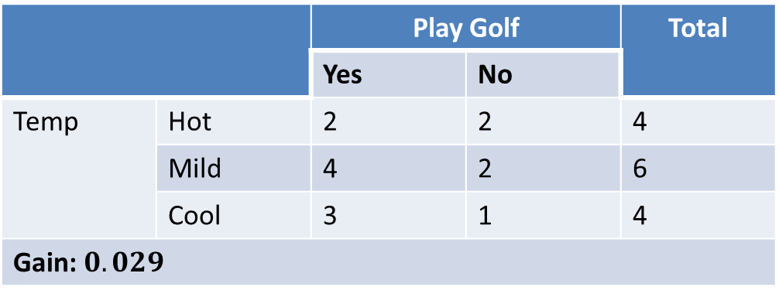
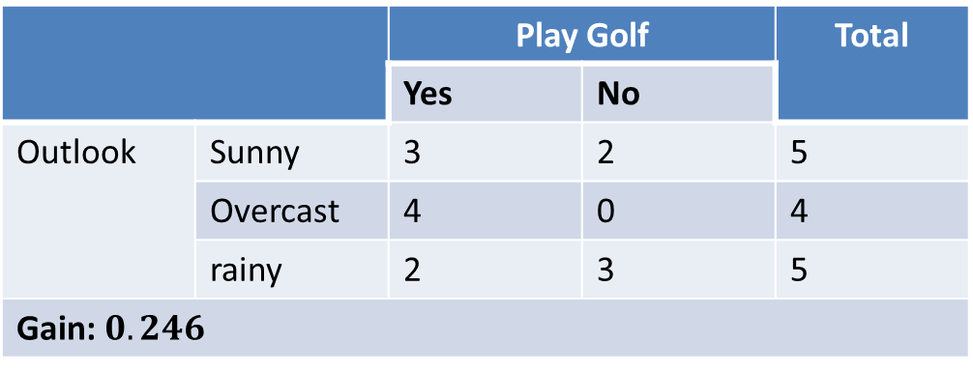
Find The Information Gain
 |  | Play Golf |  | Total
 |  | Yes | No
Outlook | Sunny | 3 | 2 | 5
 | Overcast | 4 | 0 | 4
 | rainy | 2 | 3 | 5
Gain: $0.246$
 |  | Play Golf |  | Total
 |  | Yes | No
Temp | Hot | 2 | 2 | 4
 | Mild | 4 | 2 | 6
 | Cool | 3 | 1 | 4
Gain: $0.029$

Slide 26
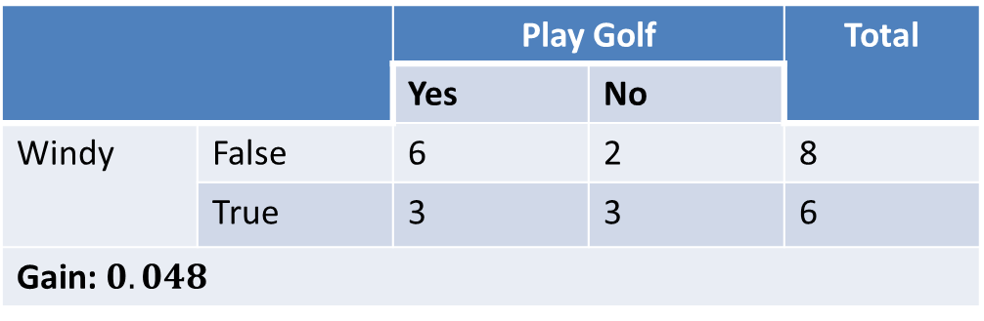
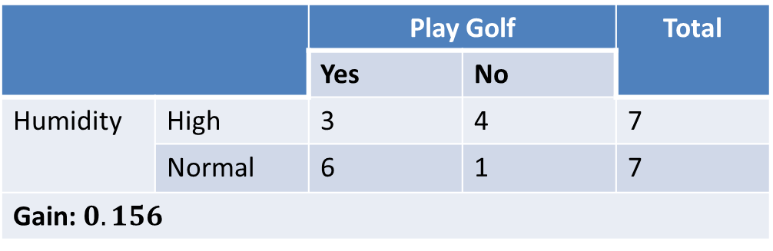
Find The Information Gain
 |  | Play Golf |  | Total
 |  | Yes | No
Humidity | High | 3 | 4 | 7
 | Normal | 6 | 1 | 7
Gain: $0.156$
 |  | Play Golf |  | Total
 |  | Yes | No
Windy | False | 6 | 2 | 8
 | True | 3 | 3 | 6
Gain: $0.048$

Slide 27
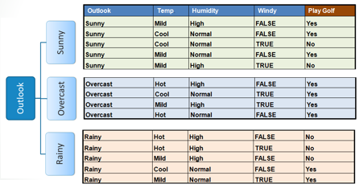
After getting all the information gain for each predictors.
Choose attribute with the largest information gain as the decision node, divide the dataset by its branches and repeat the same process on every branch.

Slide 28
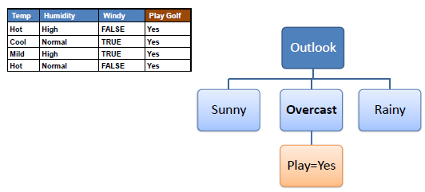
A branch with entropy of 0 is a leaf node.

Slide 29
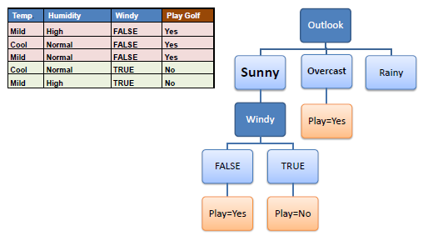
A branch with entropy more than 0 needs further splitting

Slide 30
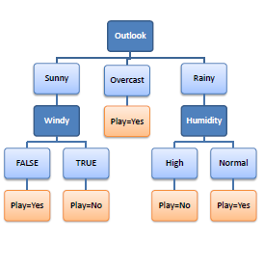
Final Result

Slide 31
Most Influential Decision Tree Algorithm
ID3 – Iterative Dichotomizer 3
C4.5
CART
etc

Slide 32
Advantages and Disadvantages of Decision Tree
(+) Easy to interpret and communicate
(+) Independent of feature scaling
(-) Easy to overfit
(-) Elaborate pruning required
(-) Expensive to just fit a “diagonal line”
(-) Output range is bounded (dep. on training examples) in regression trees

Slide 33
References
Sebastian Raschka, Machine Learning: Lecturer Notes, University of Wisconsin-Madison, https://sebastianraschka.com/pdf/lecture-notes/stat479fs18/06_trees_notes.pdf
Roger Groose, Amir-Massoud Farahmand and Juan Carrasquilla, CS411 Lecture 3: Decision Trees, University of Toronto, https://www.cs.toronto.edu/~rgrosse/courses/csc411_f18/slides/lec03-slides.pdf
Saed Sayad, Decision Tree – Classification, https://www.saedsayad.com/decision_tree.htm

